Slide 1
Cornerstone City Church Peninsula Plus Community Hoo Are Ya
03-09-2023

Slide 2
Ancient Of Days
CCLI Song # 798108
Gary Sadler | Jamie Harvill
© 1992 Integrity's Hosanna! Music
For use solely with the SongSelect® Terms of Use. All rights reserved. www.ccli.com
CCLI License # 33265

Slide 3
1/3
Blessing and honor glory and power
Be unto the Ancient of Days
From ev'ry nation all of creation
Bow before the Ancient of Days

Slide 4
2/3
Ev'ry tongue in heaven and earth
Shall declare Your glory
Ev'ry knee shall bow at Your throne
In worship
You will be exalted O God
And Your kingdom shall not pass away
O Ancient of Days

Slide 5
3/3
Your kingdom shall reign
Over all the earth
Sing unto the Ancient of Days
For none can compare
To Your matchless worth
Sing unto the Ancient of Days

Slide 6
I Know Who I Am
CCLI Song # 7115745
Osinachi Kalu Okoro Egbu
© 2013 Integrity Music
For use solely with the SongSelect® Terms of Use. All rights reserved. www.ccli.com
CCLI License # 33265

Slide 7
1/4
We are a chosen generation
Called forth to show His excellence
All I require for life God has given me
I know who I am Repeat

Slide 8
2/4
I know who God says I am what He says I am
Where He says I'm at I know who I am
I know who God says I am what He says I am
Where He says I'm at I know who I am Repeat

Slide 9
3/4
I'm working in power I'm working miracles
I live a life of favour I know who I am
I'm working in power I'm working miracles
I live a life of favour I know who I am Repeat

Slide 10
4/4
Take a look at me I'm a wonder
It doesn't matter what you see now
Can you see His glory I know who I am

Slide 11


Slide 12
Worthy Is The Lamb
CCLI Song # 3217555
Darlene Zschech
© 2000 Wondrous Worship
For use solely with the SongSelect® Terms of Use. All rights reserved. www.ccli.com
CCLI License # 33265

Slide 13
1/3
Thank You for the cross Lord
Thank You for the price You paid
Bearing all my sin and shame
In love You came and gave amazing grace

Slide 14
2/3
Thank You for this love Lord
Thank You for the nail-pierced hands
Washed me in Your cleansing flow
Now all I know Your forgiveness and embrace

Slide 15
3/3
Worthy is the Lamb seated on the throne
Crown You now with many crowns
You reign victorious
High and lifted up Jesus Son of God
The Darling of heaven crucified
Worthy is the Lamb
Worthy is the Lamb

Slide 16
3/3
Crucified laid behind the stone
You lived to die rejected and alone
Like a rose trampled on the ground
You took the fall and thought of me
Above all

Slide 17
Above All
CCLI Song # 2672885
Lenny LeBlanc | Paul Baloche
© 1999 Integrity's Hosanna! Music; LenSongs Publishing
For use solely with the SongSelect® Terms of Use. All rights reserved. www.ccli.com
CCLI License # 33265

Slide 18
1/3
Above all powers above all kings
Above all nature and all created things
Above all wisdom and all the ways of man
You were here before the world began

Slide 19
2/3
Above all kingdoms above all thrones
Above all wonders the world has ever known
Above all wealth and treasures of the earth
There's no way to measure
What You're worth

Slide 20
3/3
Crucified laid behind the stone
You lived to die rejected and alone
Like a rose trampled on the ground
You took the fall and thought of me
Above all

Slide 22
King of Kings
CCLI Song # 7127647
Brooke Ligertwood | Jason Ingram | Scott Ligertwood
© 2019 Fellow Ships Music (Admin. by Essential Music Publishing LLC)
So Essential Tunes (Admin. by Essential Music Publishing LLC)
Hillsong Music Publishing Australia (Admin. by Hillsong Music Publishing UK)
For use solely with the SongSelect® Terms of Use. All rights reserved. www.ccli.com
CCLI Licence No. 33265

Slide 23
1/10
In the darkness we were waiting
Without hope without light
Till from Heaven You came running
There was mercy in Your eyes

Slide 24
2/10
To fulfil the law and prophets
To a virgin came the Word
From a throne of endless glory
To a cradle in the dirt

Slide 25
3/10
Praise the Father
Praise the Son
Praise the Spirit three in one
God of Glory
Majesty
Praise forever to the King of kings

Slide 26
4/10
To reveal the kingdom coming
And to reconcile the lost
To redeem the whole creation
You did not despise the cros

Slide 27
5/10
For even in Your suffering
You saw to the other side
Knowing this was our salvation
Jesus for our sake You died

Slide 28
6/10
And the morning that You rose
All of heaven held its breath
Till that stone was moved for good
For the Lamb had conquered death

Slide 29
7/10
And the dead rose from their tombs
And the angels stood in awe
For the souls of all who'd come
To the Father are restored

Slide 30
8/10
And the Church of Christ was born
Then the Spirit lit the flame
Now this Gospel truth of old
Shall not kneel shall not faint

Slide 31
9/10
By His blood and in His Name
In His freedom I am free
For the love of Jesus Christ
Who has resurrected me

Slide 32
10/10
Praise the Father
Praise the Son
Praise the Spirit three in one
God of Glory
Majesty
Praise forever to the King of kings

Slide 33


Slide 34
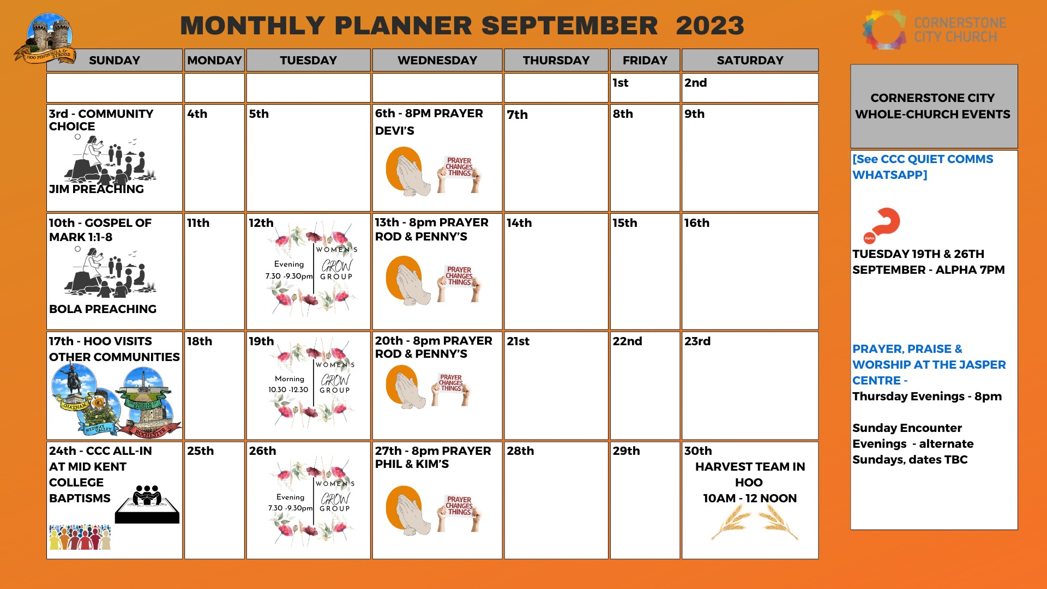

Slide 35
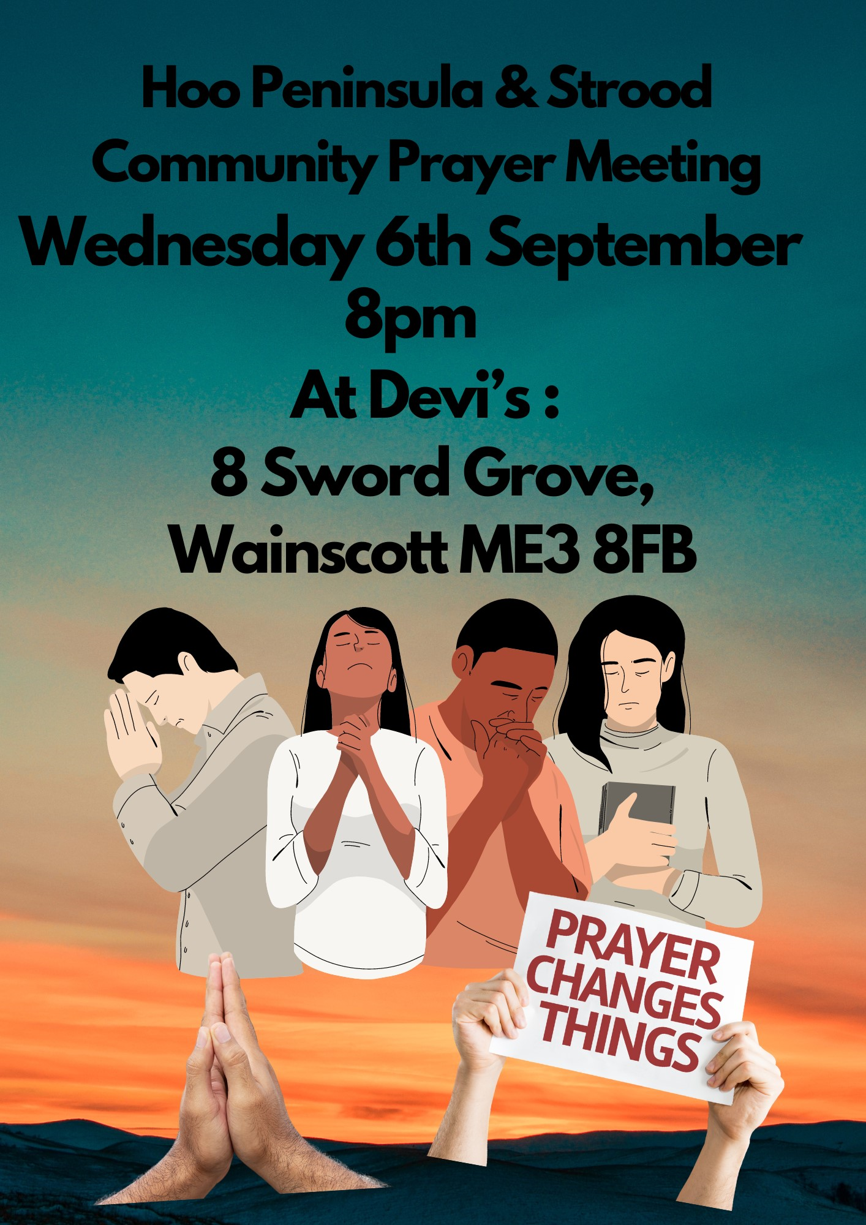

Slide 36


Slide 37


Slide 38


Slide 39
2 Corinthians 14 May the grace of the Lord Jesus Christ, and the love of God, and the fellowship of the Holy Spirit be with you all

